Slide 1
DriverPass System Analysis
Rotina Staples
Southern New Hampshire University
CS 255: Systems Analysis and Design
Christopher Overly
December 15, 2024
Notes:
Welcome to the DriverPass System Analysis presentation. This presentation outlines the proposed system design, including its requirements, diagrams, and limitations.

Slide 2
System Requirements
Functional Requirements:
- Enable customers to make, modify, and cancel reservations online.
- Provide IT Officer with tools to manage roles and access rights.
Non-Functional Requirements:
- Cloud-based hosting for scalability and reliability.
- Role-based security to ensure data integrity.
Notes:
This slide highlights the functional and non-functional requirements of the DriverPass system. Functionally, the system will allow customers to manage reservations and provide IT tools to manage roles. Non-functional requirements focus on reliability, security, and scalability through cloud-based hosting.

Slide 3
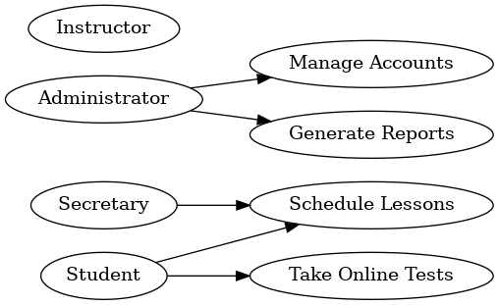
Refer to the attached 'Use Case Diagram' for details.
Notes:
This Use Case Diagram represents the interactions between the system and its primary users: the Instructor, Administrator, Secretary, and Student. It outlines the system's core functions, including managing accounts, generating reports, scheduling lessons, and taking online tests.

Slide 4
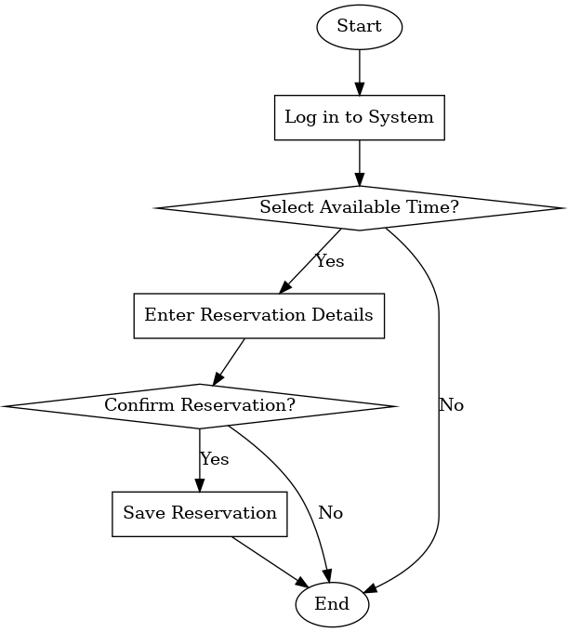
Activity Diagram
Refer to the attached 'Customer Reservation Activity Diagram' for details.
Notes:
This Activity Diagram shows the workflow for a customer making a reservation. The process starts with logging into the system, selecting an available time, entering details, and confirming the reservation. It includes decision points to ensure accuracy.

Slide 5
Sequence Diagram (Customer Reservation)
Notes:
This Sequence Diagram outlines the interactions between the customer, the DriverPass system, and the database during a reservation.
The customer logs in, and the system validates credentials with the database.
After selecting a time slot, the system checks for availability and saves the reservation.
The process ends with a confirmation sent to the customer.

Slide 6
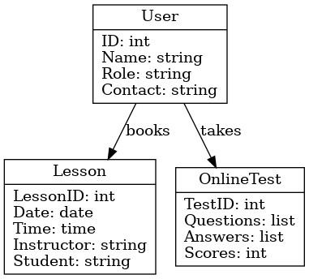
Class Diagram (DriverPass System)
Notes:
The Class Diagram illustrates the core structure of the DriverPass system.
The User class represents system users like customers, IT officers, and secretaries.
Reservations track time slots and status.
Packages represent lesson plans with pricing.
Drivers manage instructor details and are assigned to Cars.
Relationships include users making reservations and drivers being assigned vehicles.

Slide 7
Security
- Role-based access control (RBAC) to enforce user permissions.
- Encryption for sensitive data such as passwords and credit card information.
- Audit trails to monitor and log user actions.
- Regular updates to ensure compliance with DMV regulations.
Notes:
Security is a priority in the DriverPass system. Role-based access ensures only authorized users can perform specific actions. Sensitive data, such as passwords, is encrypted. Audit trails are in place to monitor user actions, and regular updates ensure compliance with DMV standards.

Slide 8
System Limitations
- Data access requires internet connectivity.
- Package modifications require developer intervention.
- Limited offline capabilities for data viewing only.
Notes:
While the system is robust, it has a few limitations. Internet connectivity is required to access the system, and modifying packages currently requires developer involvement. Additionally, offline capabilities are limited to viewing preloaded data only.

